Slide 1
Topic: Statistics
EQ: How can we use statistical language to describe steam and leaf plots?

Slide 2
Topic: Statistics
EQ: How can we use statistical language to describe stem and leaf plots?
Starter – Daily 5
1. Which side does is the ‘tail’ on a graph with a negative skew?
2. A full water tank has sprung a leak. It loses 5% of its contents every minute. Work out how long until the tank loses 40% of its contents.
3. Write the sample space for flipping a coin twice
4. What is the median and range of the following set of numbers: 2,3,7,9,13,19
5. Draw a picture of a histogram that is bi-modal (think about the peak on a symmetrical graph)

Slide 3
Activity – say it, show it, explain it
The numbers below represent the percentage that students received on their Science test.
Can you organise the information so that it is easier to understand.
56, 64, 68, 69, 55, 56, 69,
58, 55, 66, 49, 49, 63, 72,
75, 78, 55, 53, 42, 60, 85,
With a partner say what you did, show what you did, explain what you did.

Slide 4
What did you come up with?
Table?
Dot plot?
graph?
Frequency table?

Slide 5
Topic: Statistics
EQ: How can we use statistical language to describe stem and leaf plots?
Recap: What are Stem and
Leaf Plots?
A Stem and Leaf Plot is a plot where each data value is split into a "leaf" and a "stem“.
Example: 36 81
stem
leaf
stem
leaf
How do we put it together?
Example: 35, 42, 55, 49, 39, 40, 55, 33, 51
-fill in the rest
NOT DONE YET – PUT ‘leaves’ IN ORDER
stem
leaf
3 | 5
3 | 3 5 9
4 | 0 2 9
5 | 1 5 5
4 2

Slide 6
Your turn
The numbers below represent the percentage students received in their test.
Can you organise the information into a STEM-AND-LEAF plot
56, 64, 68, 69, 55, 56, 69,
58, 55, 66, 49, 49, 63, 72,
75, 78, 55, 53, 42, 60, 85,
FIND:
4 | 2 9 9
5 | 3 5 5 5 6 6 8
6 | 0 3 4 6 8 9 9
7 | 2 5 8
8 | 5
Key: 4|2 = 42

Slide 7
Interpreting Stem and Leaf Plots
The stem & leaf diagram below shows the masses in kg of some people in a lift.
How many people were weighed? c) Find the median mass
What is the range of the masses? d) Describe the shape of the data set
Stem
Leaf
tens
3
1
4
ones
Median is the mean of the 8th and 9th data values.
4
3
3
6
5
0
3
4
8
6
1
2
7
2
2
7
(a) 16 people.
(c) 56 kg
8
1
6
(b) 86 – 31 = 55 kg
(d) Symmetrical

Slide 8

Practice
Stem and Leaf Plots Worksheet
Notes:
Independent practice

Slide 9
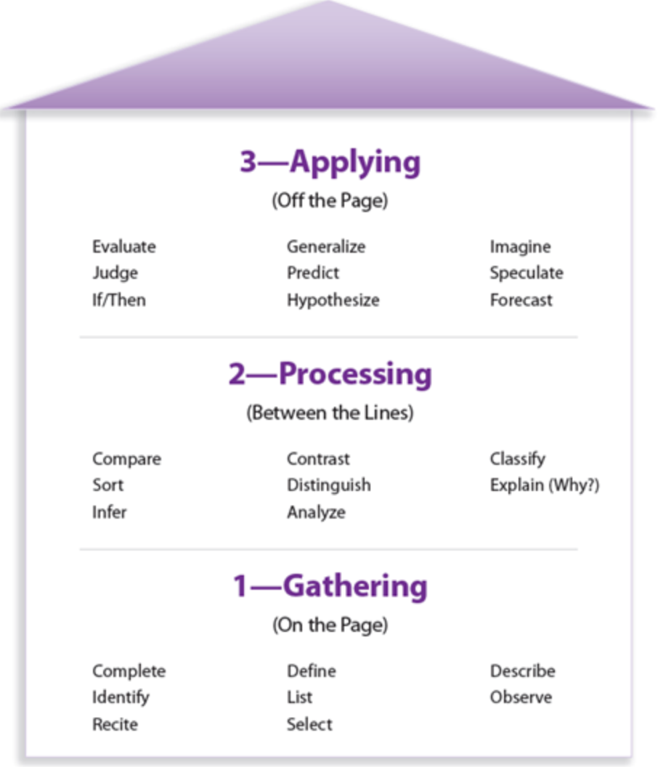
Exit ticket
With a partner, come up with a different
Essential Question based on Costa’s 3
Levels of Inquiry. The goal is to create a
Level 3 question.
Write a summary based on this new EQ
Review Notes

Slide 10
Homework
Practice test 14a

